Slide 1


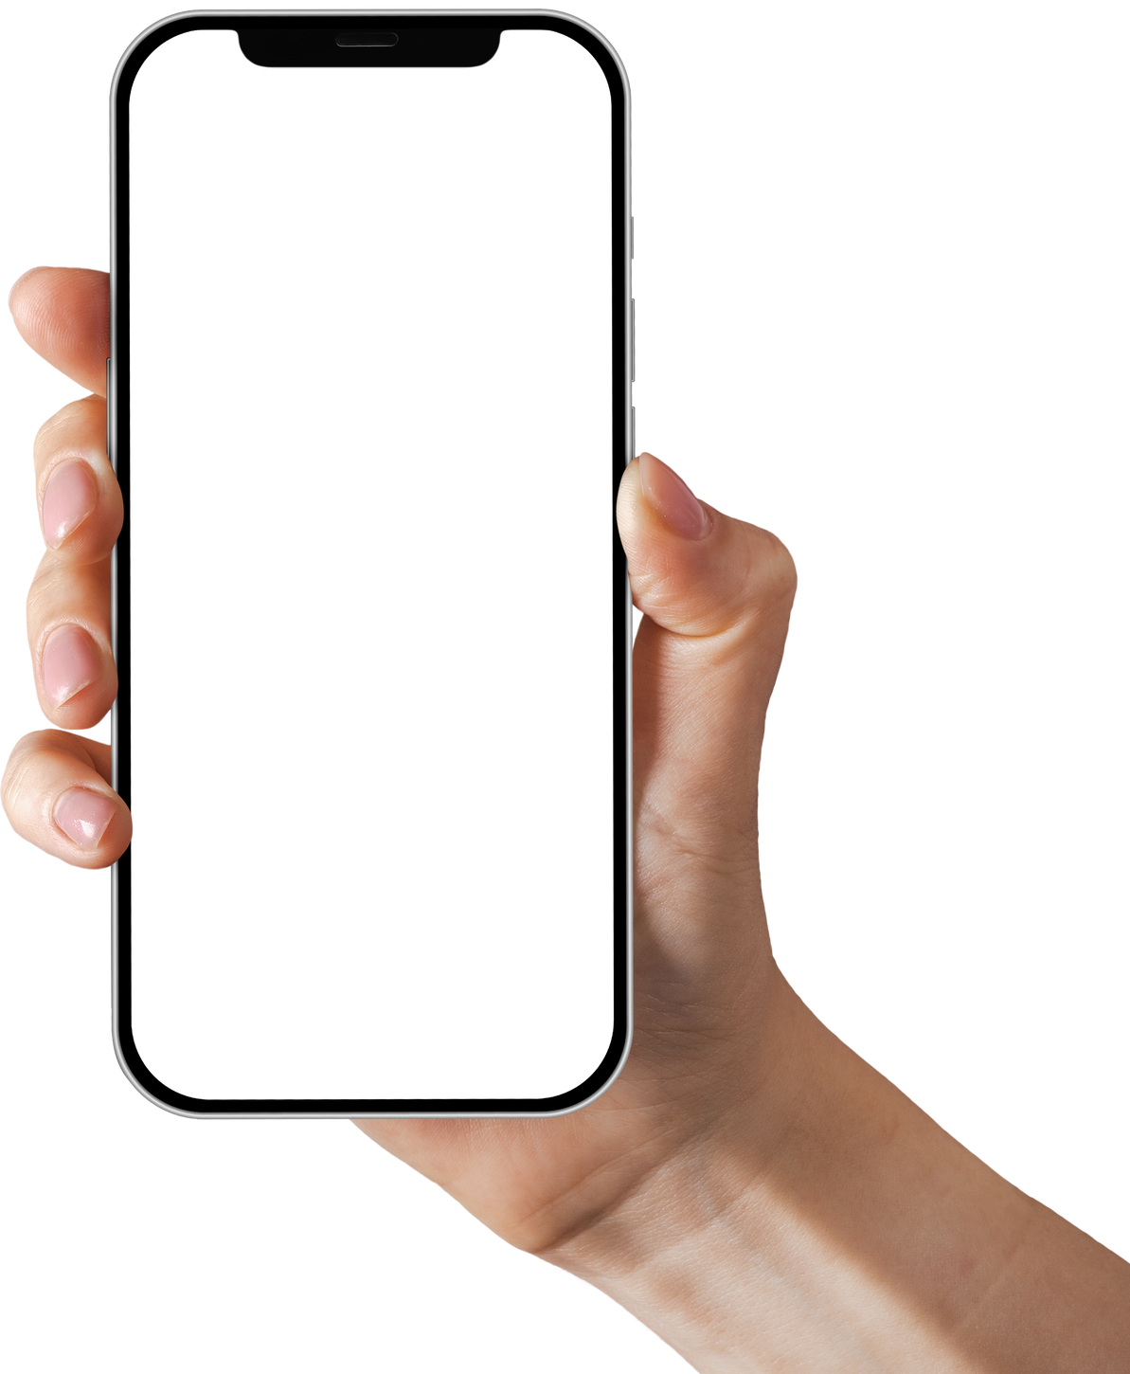
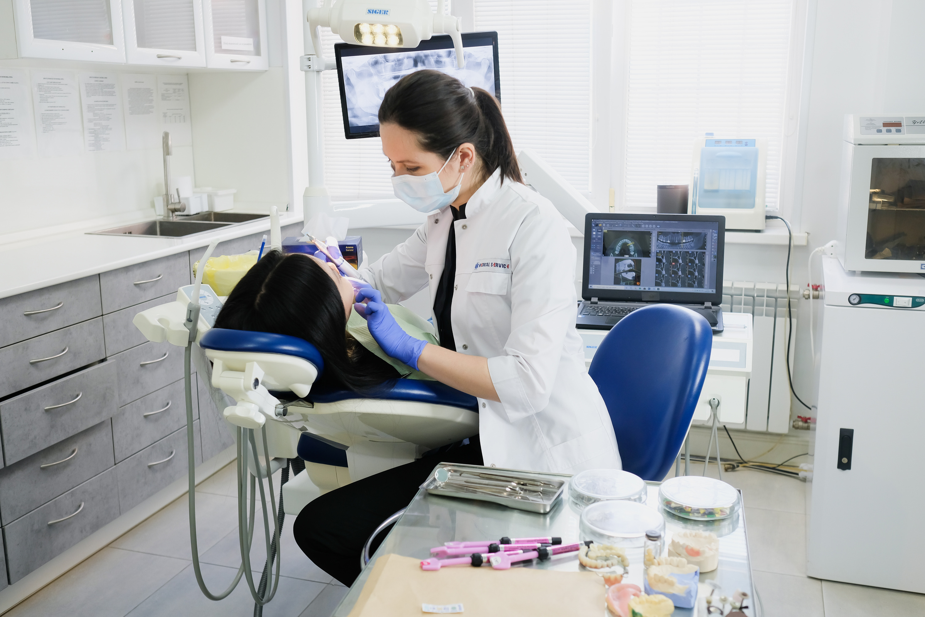

E-DENTIST
A DENTAL CARE SOLUTION
Presented by
Abu Sadat Al Rafi

Slide 2
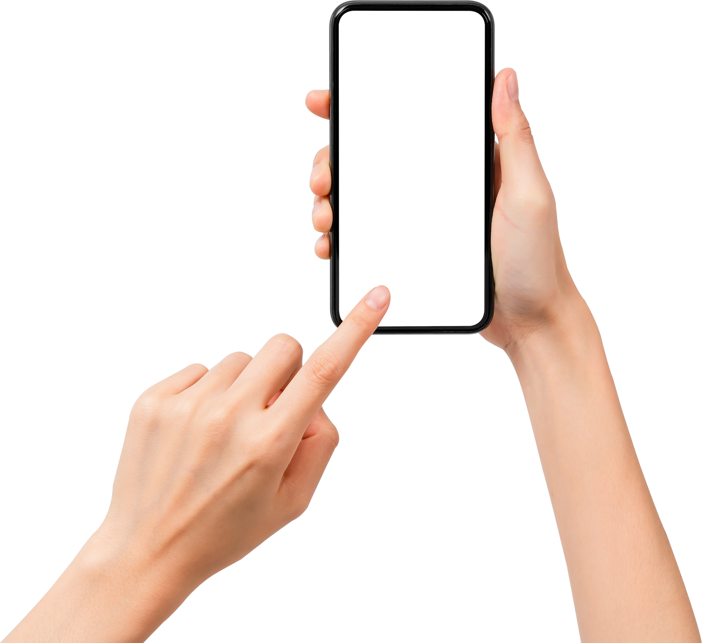
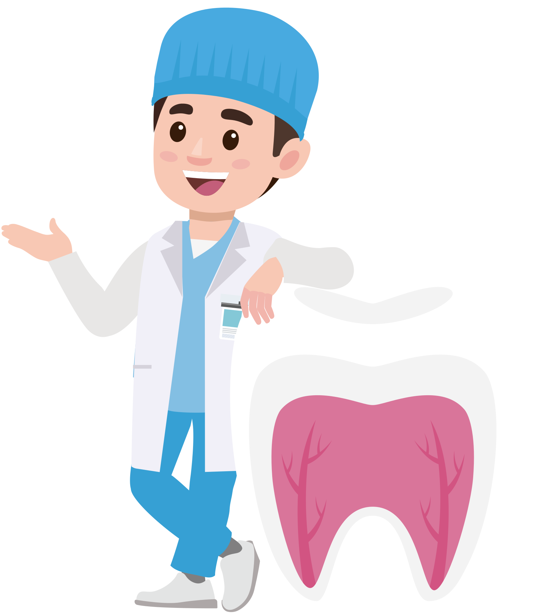
Motivation
80 percentage of the population have at least one or more oral diseases
One dental surgeon for every 0.2 million people
People of rural areas are less knowledgeable and cautious
Lack of dental facility in district level health complexes
During COVID-19 pandemic, dental clinics are shut for regular practices
Dental specialist is at the forefront of getting infected by COVID-19

Slide 3
Why E-DENTIST?
Facilitate and extend the access and delivery in oral health care [N. D. Jampani et al.]
Constructive method to increase the reach of dental expertise
Cost effective compare to conventional dental consultation [Mohamed Estai1 et al.]
Innovative approach to continue dental practice during this COVID-19 pandemic [Shantanu Deshpande et al.]
Participants expressed positive views towards Teledentistry [Naomi Rahman et al.]
Well perceived by dental specialists in dental practice [Alla T. Alsharif et al.]
Role in General and Specialty Dental Practice [Suhani Ghai]

Slide 4
E-Dentist
Combination of telecommunications and dentistry
Exchange clinical information and images over remote distances
Forms of E-Dentist
•Synchronous (Live Video)
•Asynchronous (Store and Forward)

Slide 5
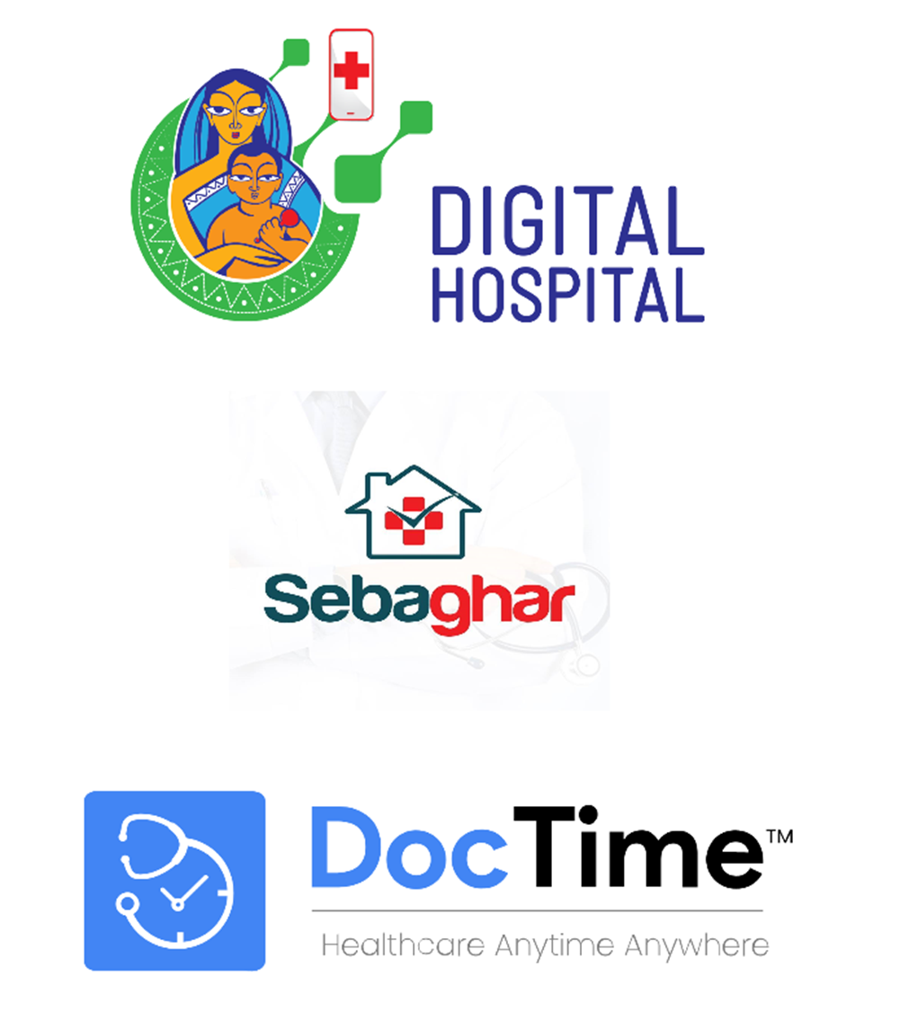
Mobile healthcare in Bangladesh
Video consultation
Digital prescription
Medication reminder
Online pharmacy
Health related blog

Slide 6
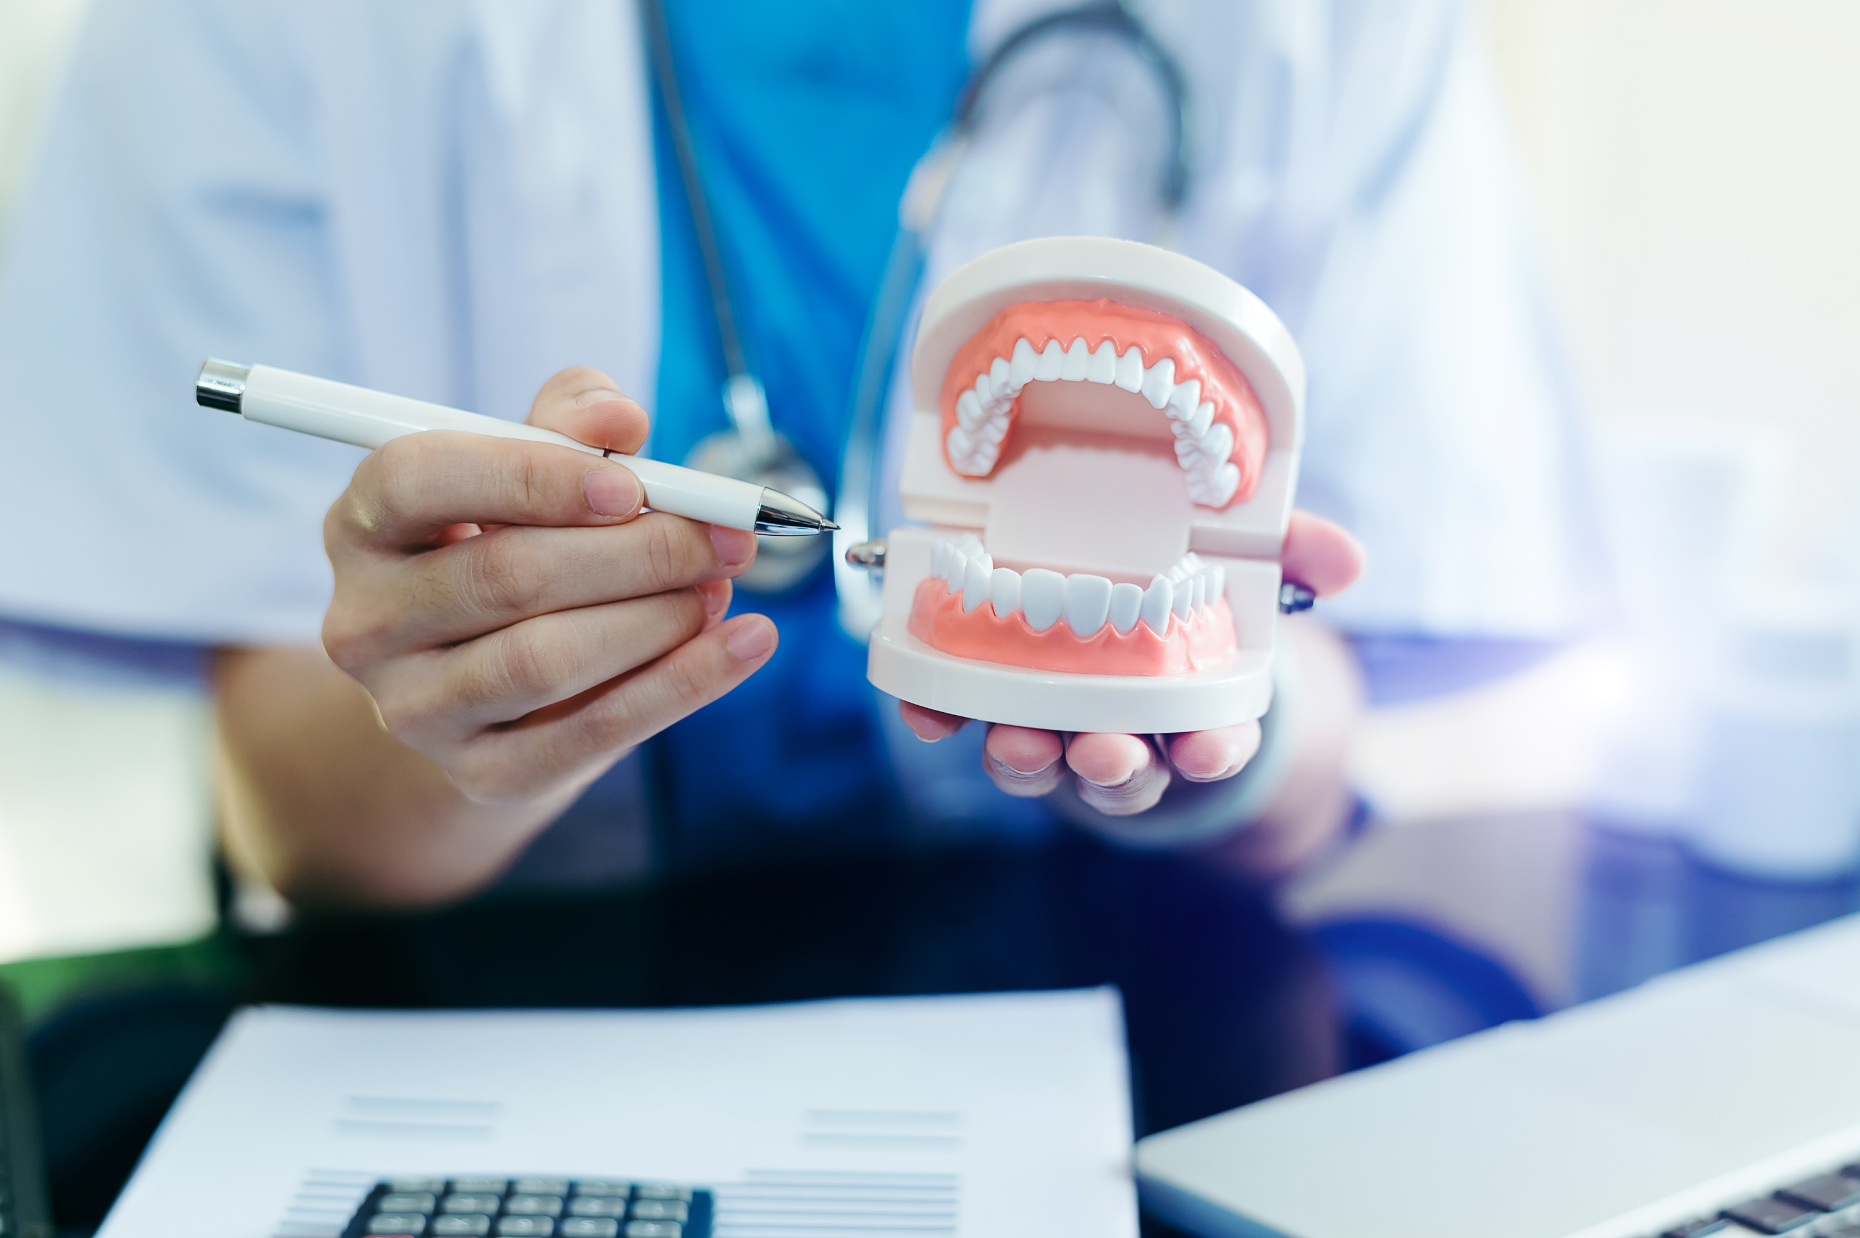
Benefits of E-Dentist
Improves access to oral health care
Broader range of access to dental specialists
Reduces operational cost of dental clinic
Lower health care costs for dental patients
Less intimidating
Oral hygiene education
Better access for people with disabilities
Time efficient for both dentist and patient

Slide 7

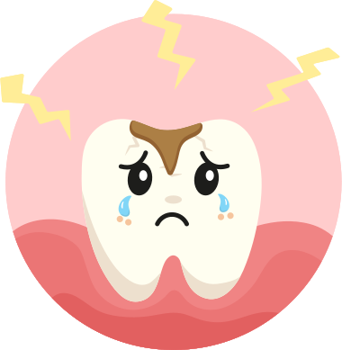
Proposed Modules
Remote consultation with the dental specialist between:
•Dental Professional and Patient
•Dental Professional and Allied Dental Personnel
Survey and monitor oral health care
Self checkups for primary oral diseases

Slide 8
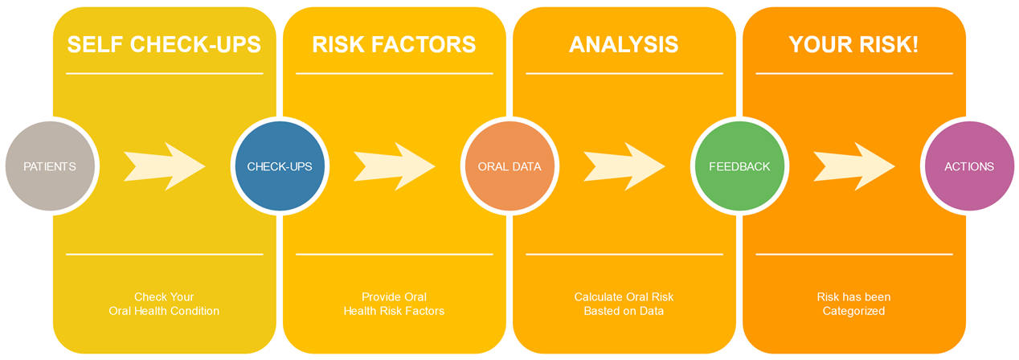
Check Your Risk!
Calculate oral health risk
Provide oral health data
Feedback based on data
Risk level recommendation

Slide 9
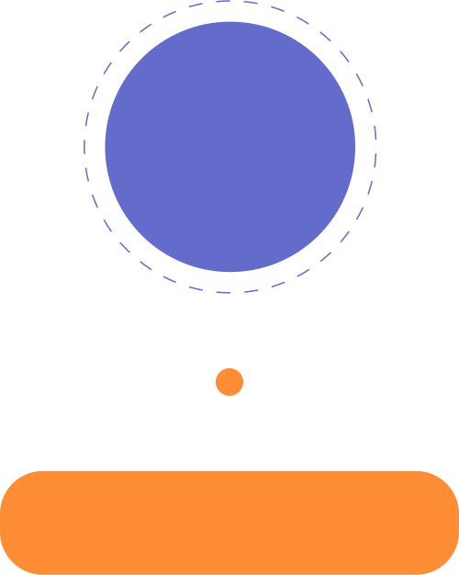
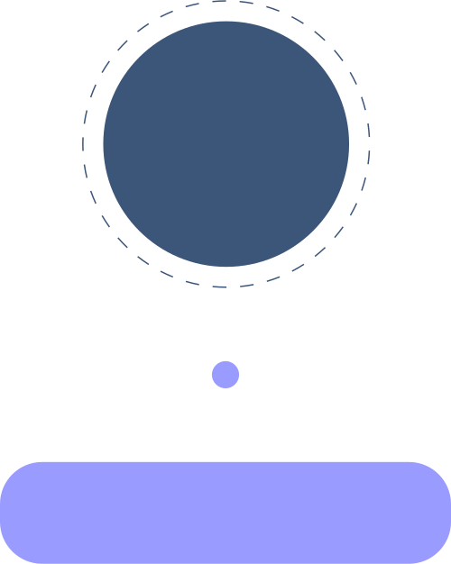

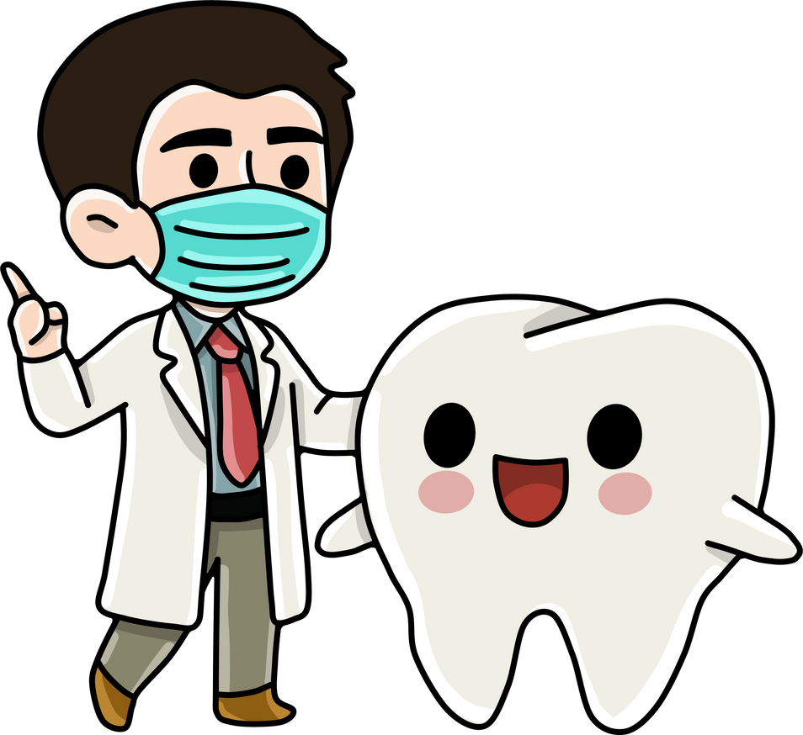





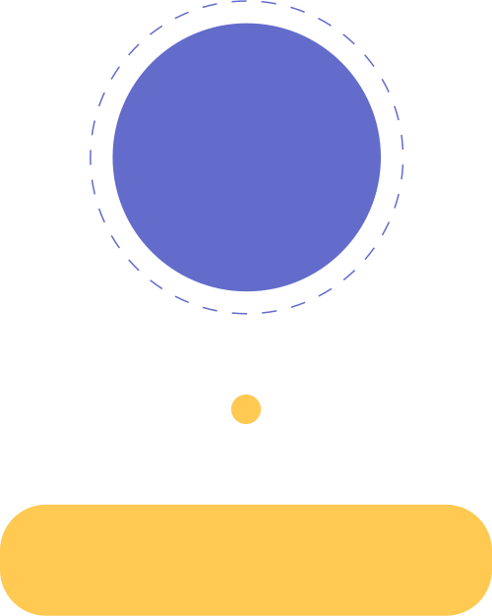
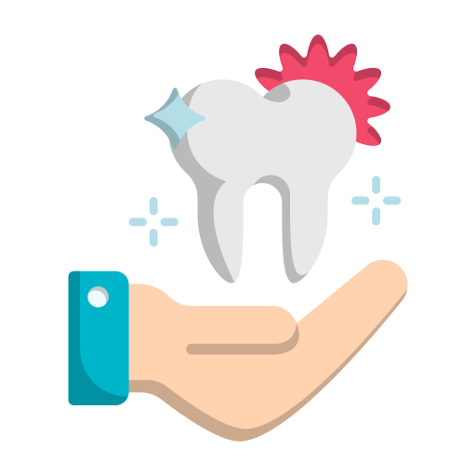

Know Before Appointment
Check Before Appointment
Analyzing Symptoms
Check yours oral symptoms whether you need any dental specialist consultancy or oral health tips.
Required actions will be recommended based on the provided oral symptom category.
01
02
03
04
My Oral Symptoms
Recommended Feedback
Provide your oral symptoms data, about your major or minor dental diseases that you are facing.
Recommended feedback will be generated based on low, mild, high risk factors about your oral health.

Slide 10

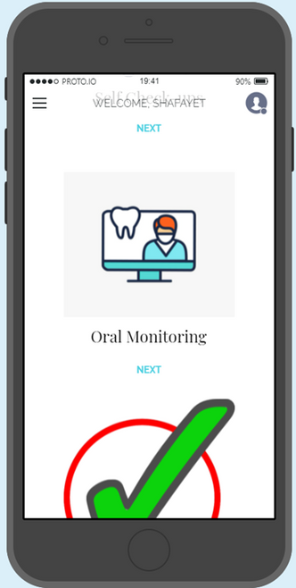
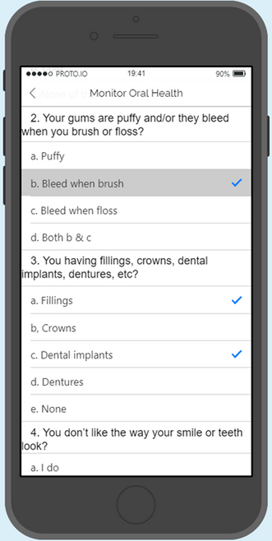
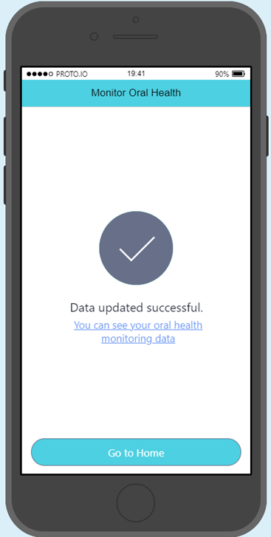
Monitor oral health
Primary oral health check-ups
Monitor oral health condition
Monitor oral risk factors
Notify for regular check-ups
Module can be implied on:
Primary oral health check-ups
Monitor oral health condition
Monitor oral risk factors
Notify for regular check-ups

Slide 11
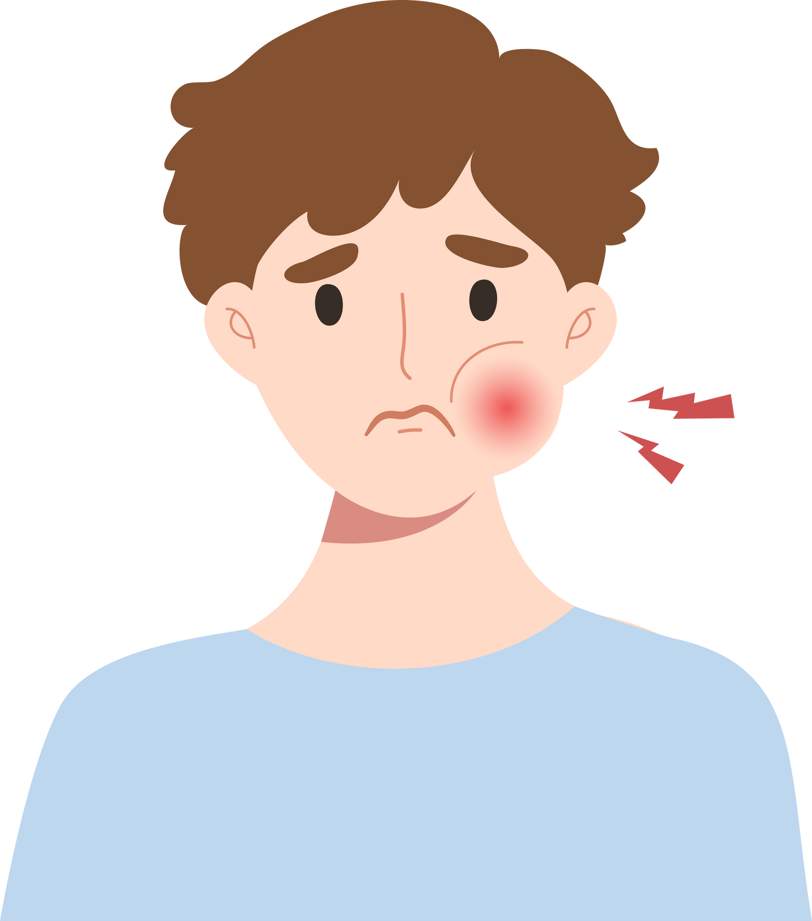
Case Diagram: Patient Preview
Registration
01
05
Oral Monitoring
Upload Document
02
06
Appointment
Self Checkup
03
07
E-prescription
Symtom checkers
04
08
Medication Reminder

Slide 12
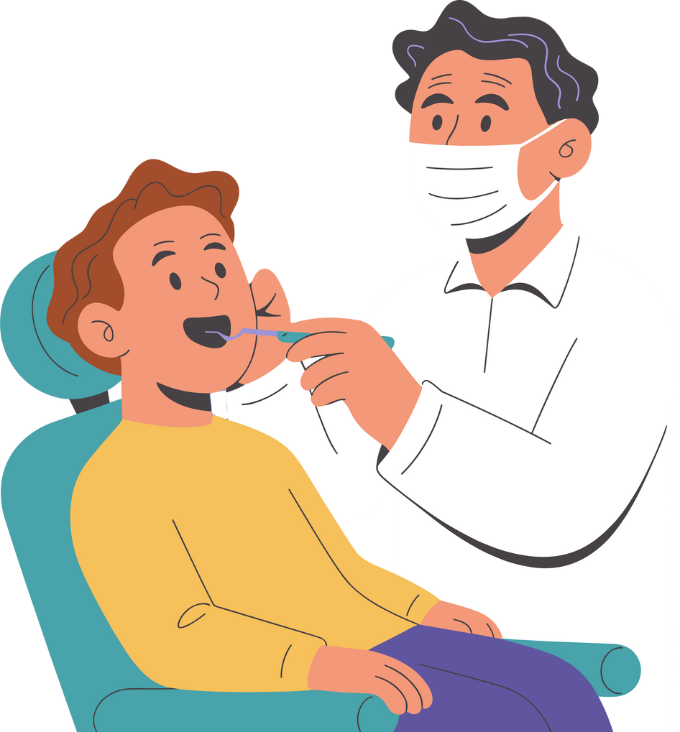
Case Diagram: Doctor Preview
Registration
01
05
Upload Documents
Login
02
06
Configuration
Patient Oral History
03
07
Generate E-prescription
04
08
Appointments Reminder
Appointment List

Slide 13

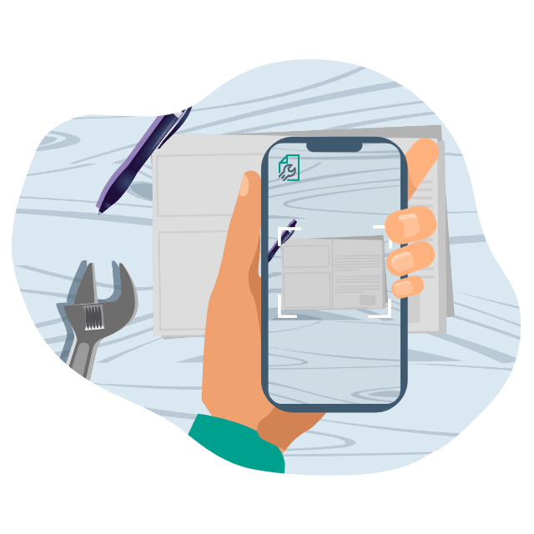

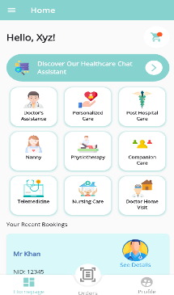
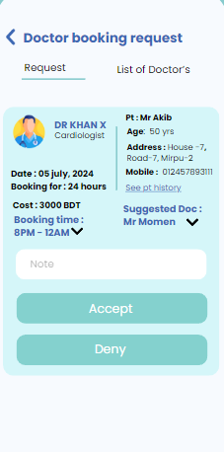


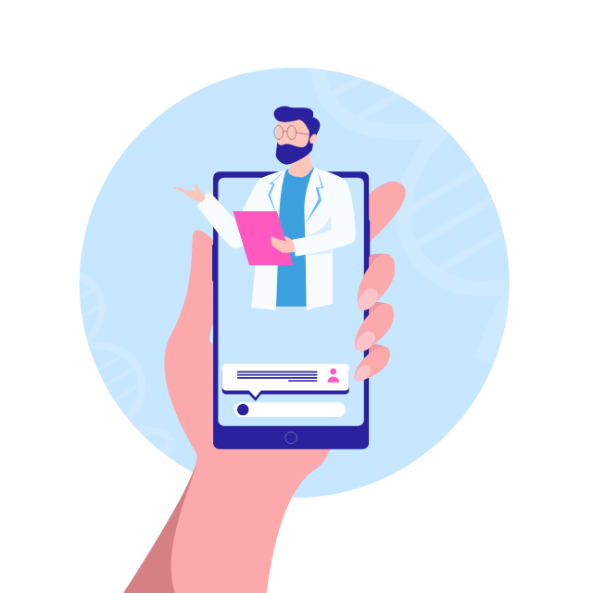


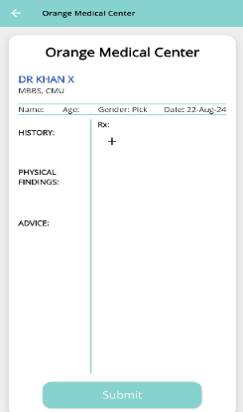


User opens the E-Dentist app for Dental consultation with a Doctor .
User is searching for a doctor to take Dental Service
User places an appointment to consult a doctor
Activity Flow
The Doctor was notify from the APP
User successfully delivered the service
User pay the bill
Doctor was give online consultation and prescription

Slide 14
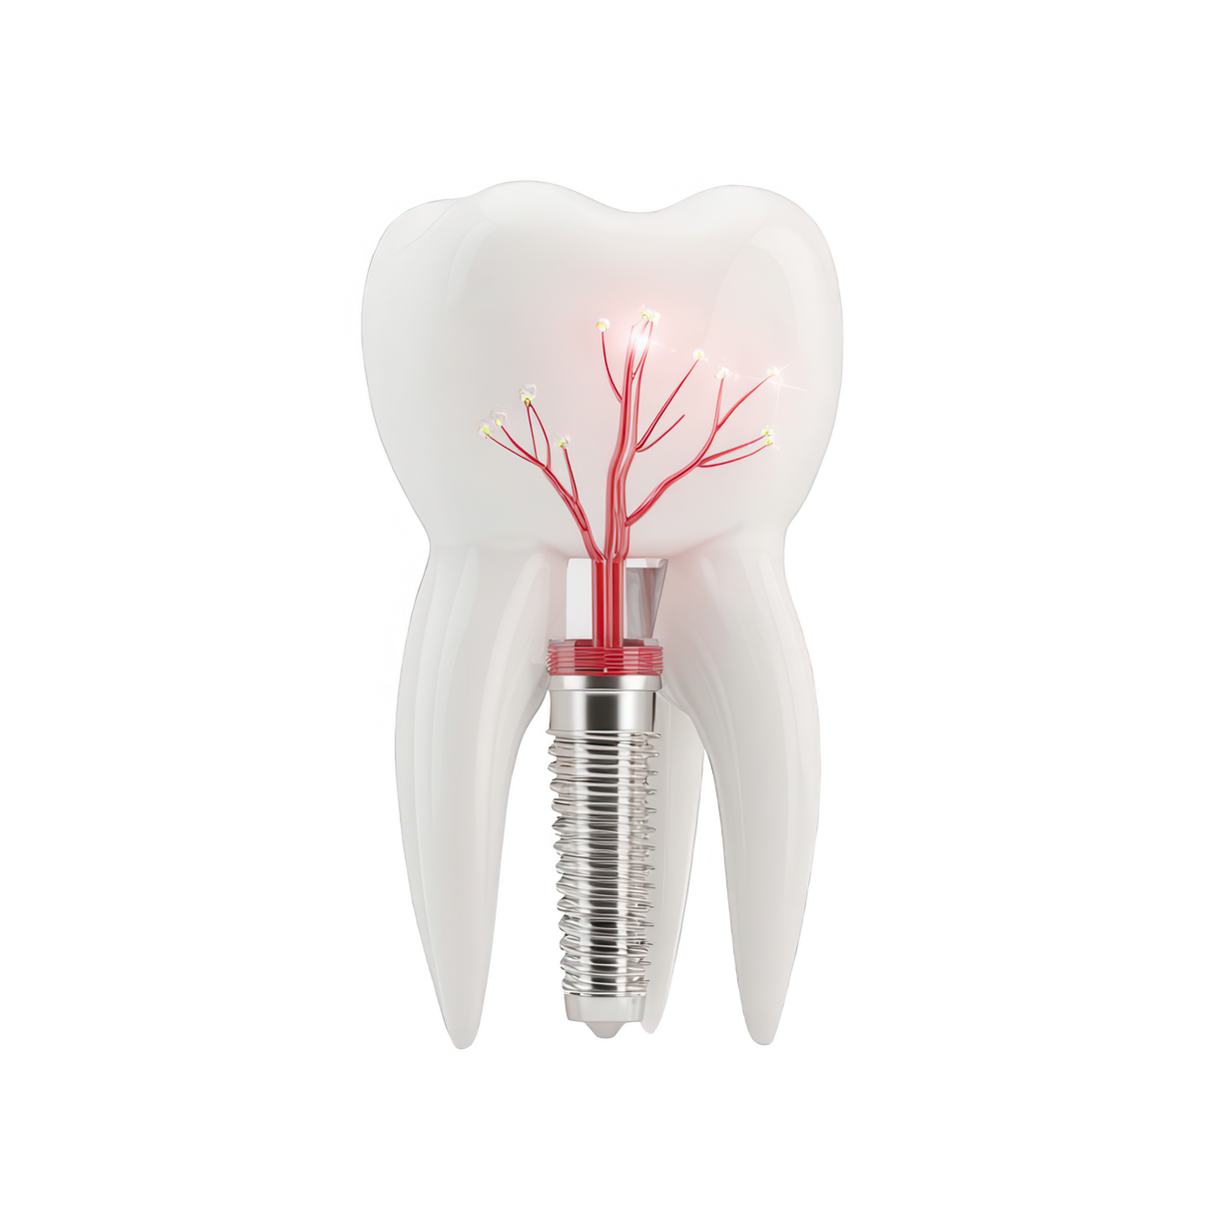
Future Prospects
Improve oral risk level detecting technique
Machine learning technique regarding symptoms checking
Provides services to disadvantaged children
Virtual oral/dental health campaign
Live chat with dental professionals on emergency
Oral health are monitoring for specific group of individuals

Slide 15
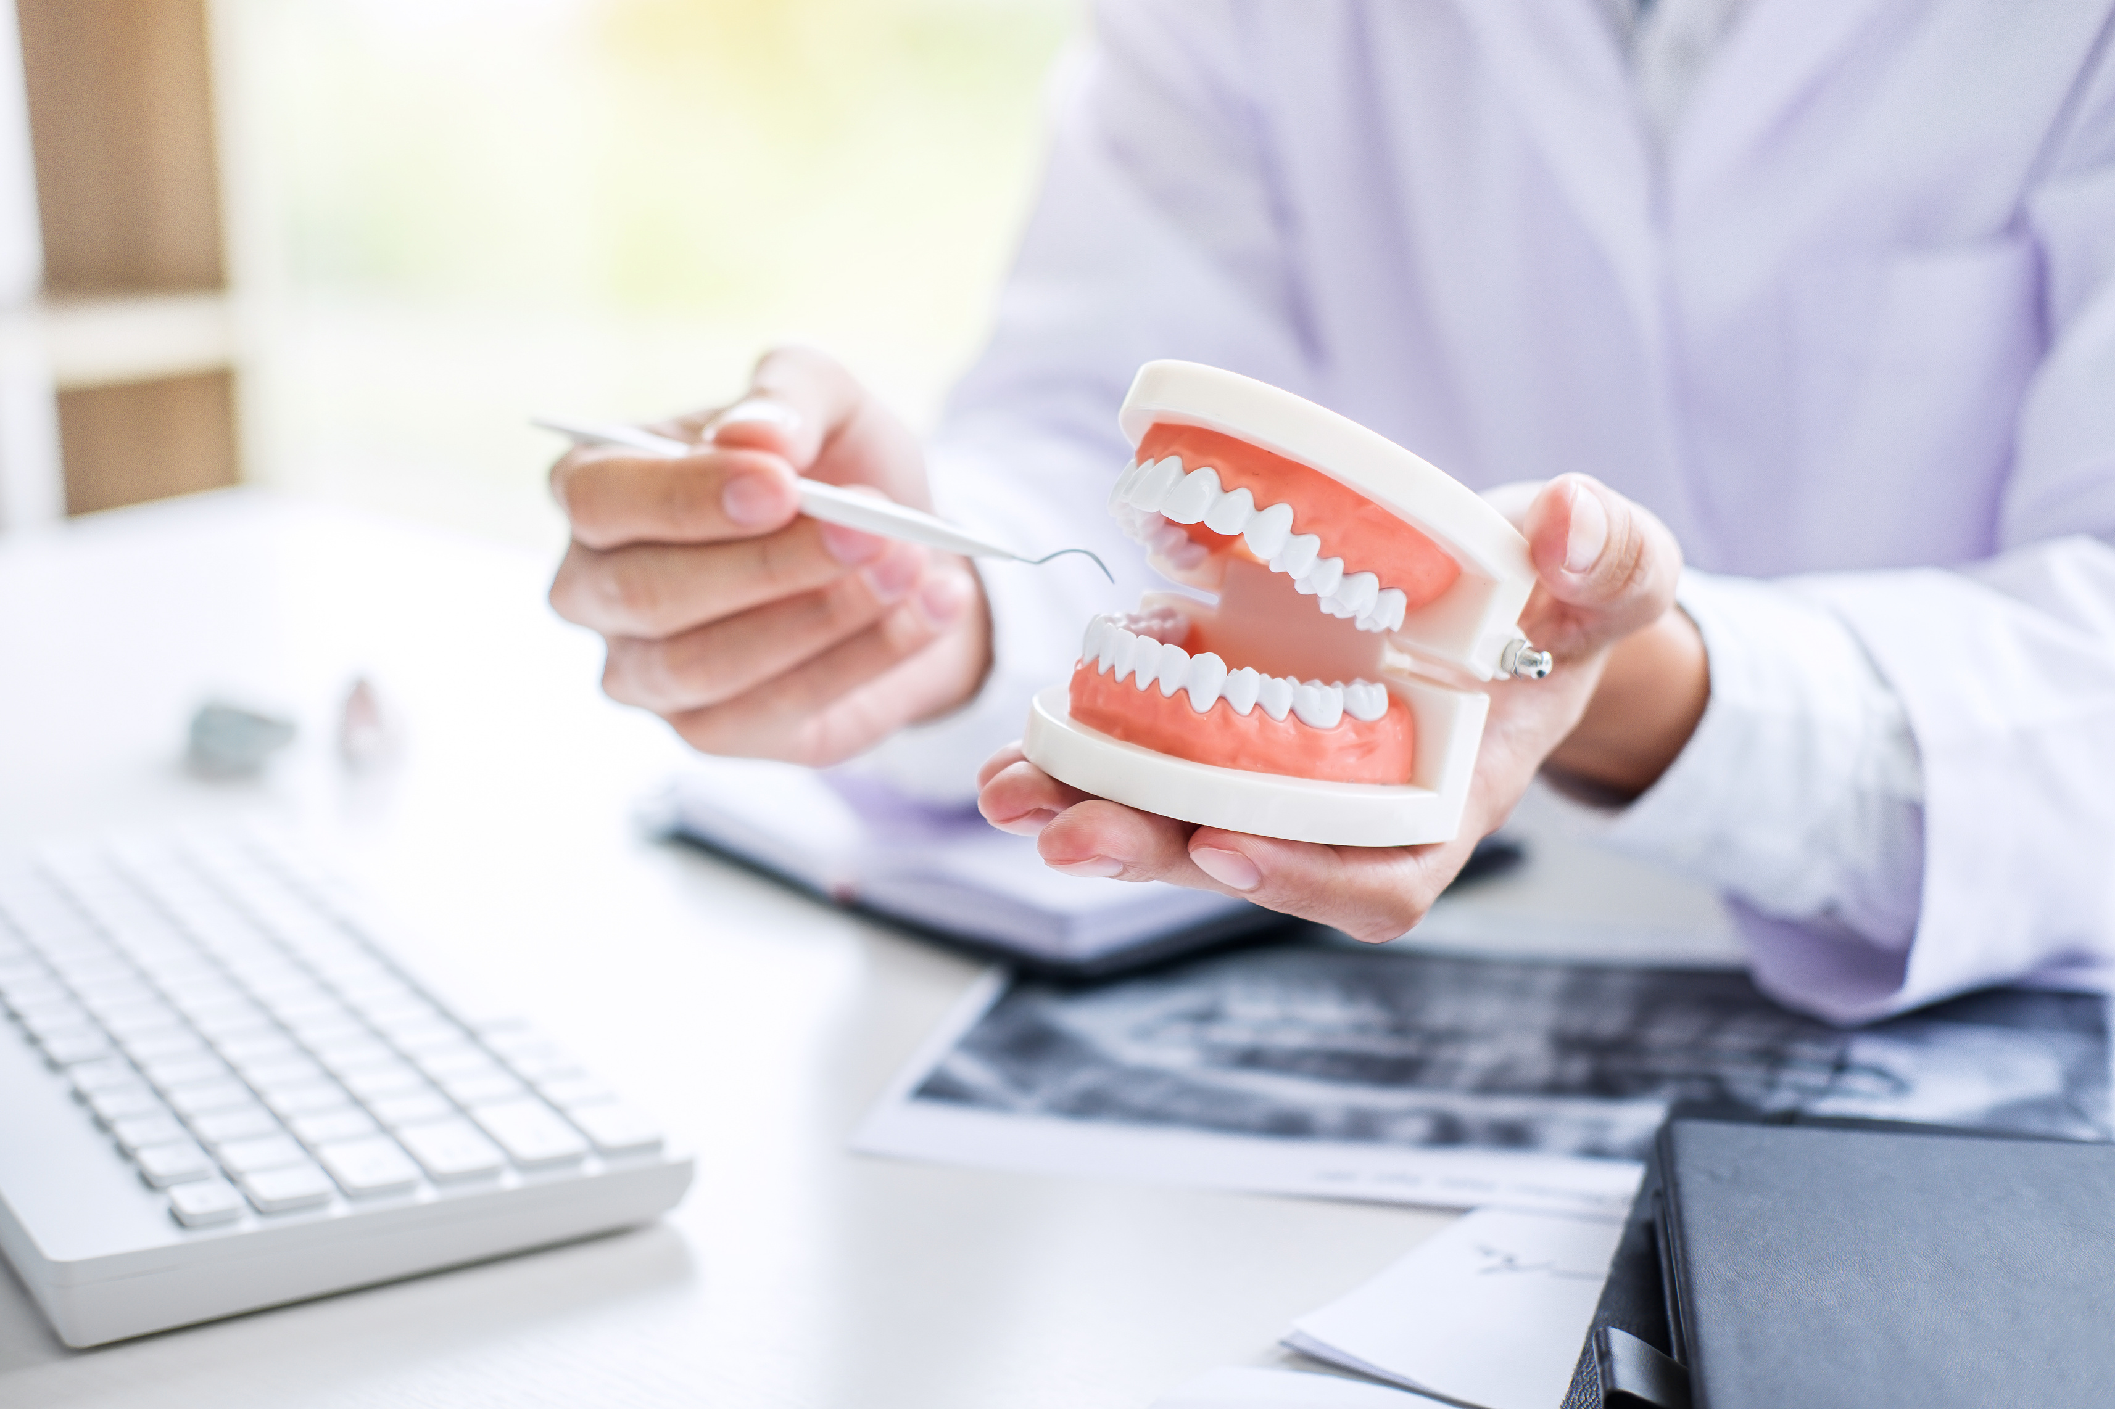
Thank You
FOR YOUR ATTENTION

